Slide 1
CONTROL CENTRAL NUCLEAR
IGNACIO JOSUE ZARATE CAMARGO
LUIS ALEJANDRO ZEBALLOS QUIROZ
JOEL MONTERO SANTAMARIA
ADRIAN ERLAN LOPEZ ALEJANDRO
MIGUEL DYLAN MENDOZA NOGALES
BY UMSEÑOS TEAM

Slide 2
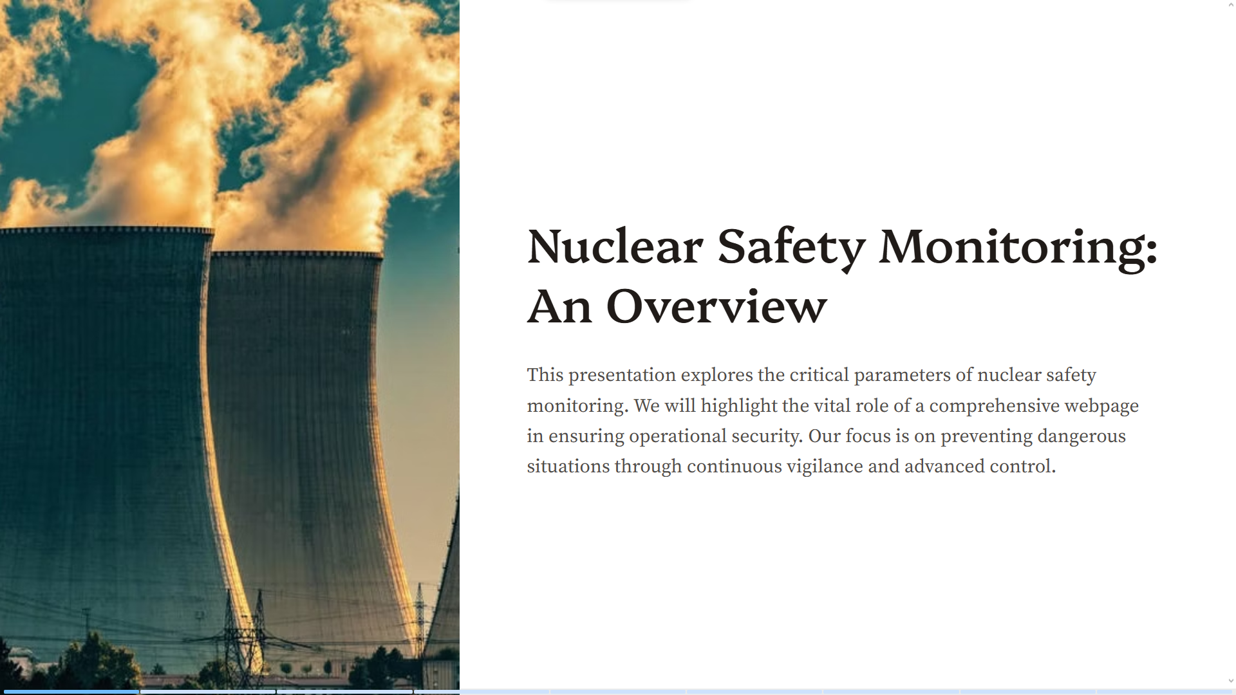

Slide 3
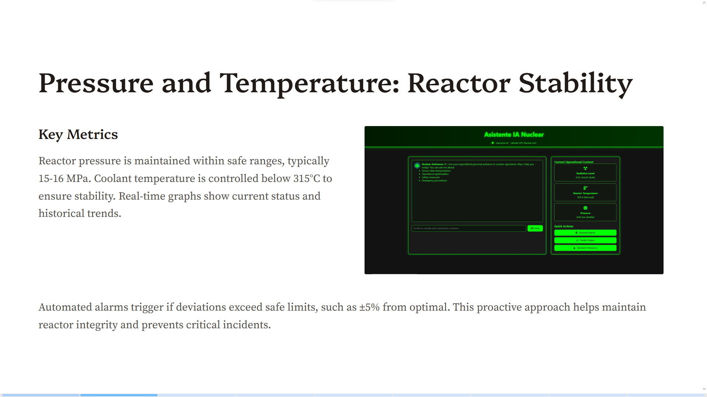

Slide 4
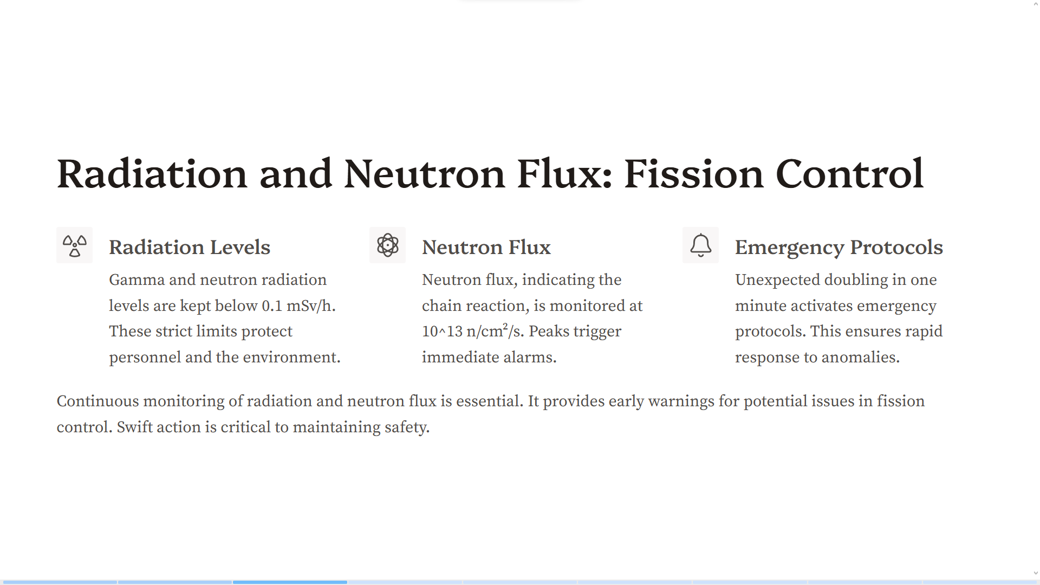

Slide 5
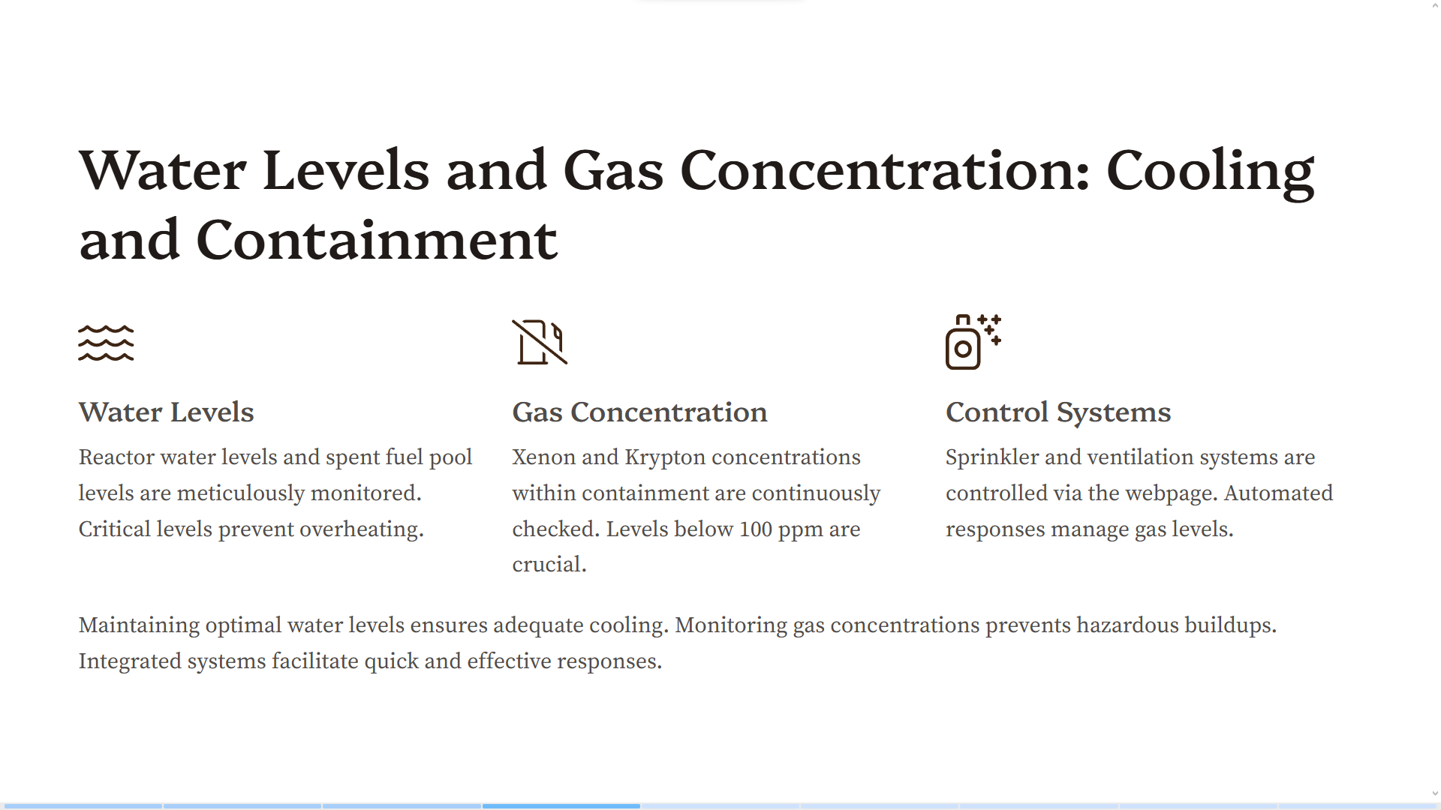

Slide 6
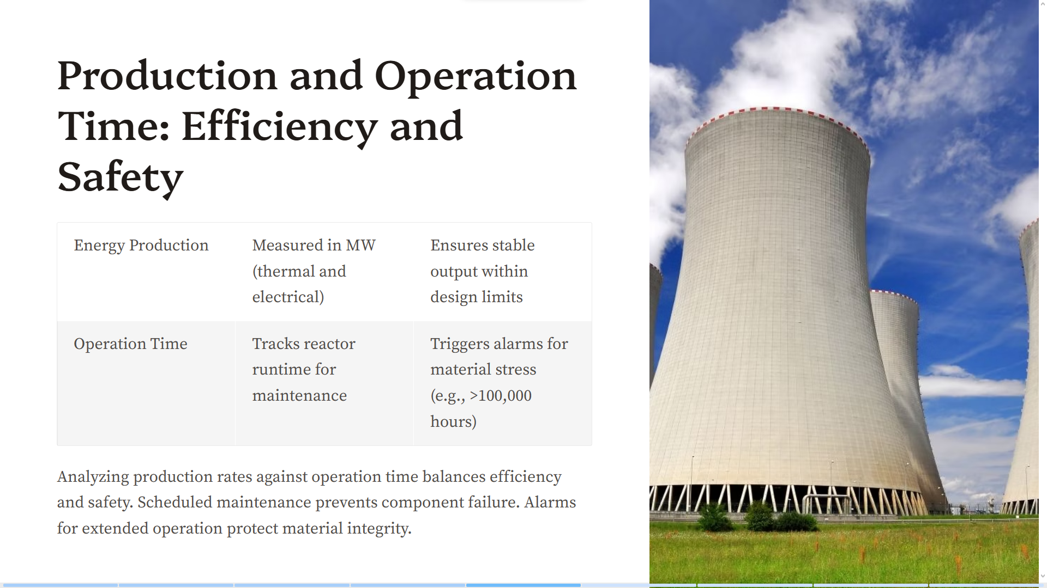

Slide 7
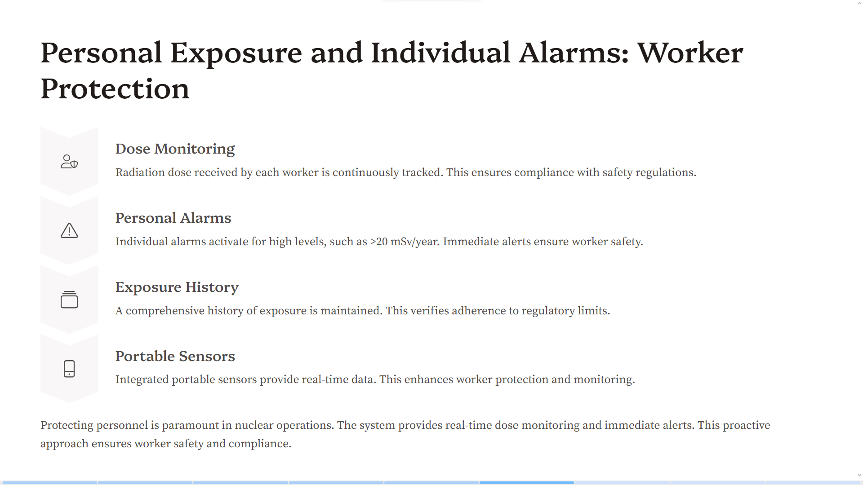

Slide 8
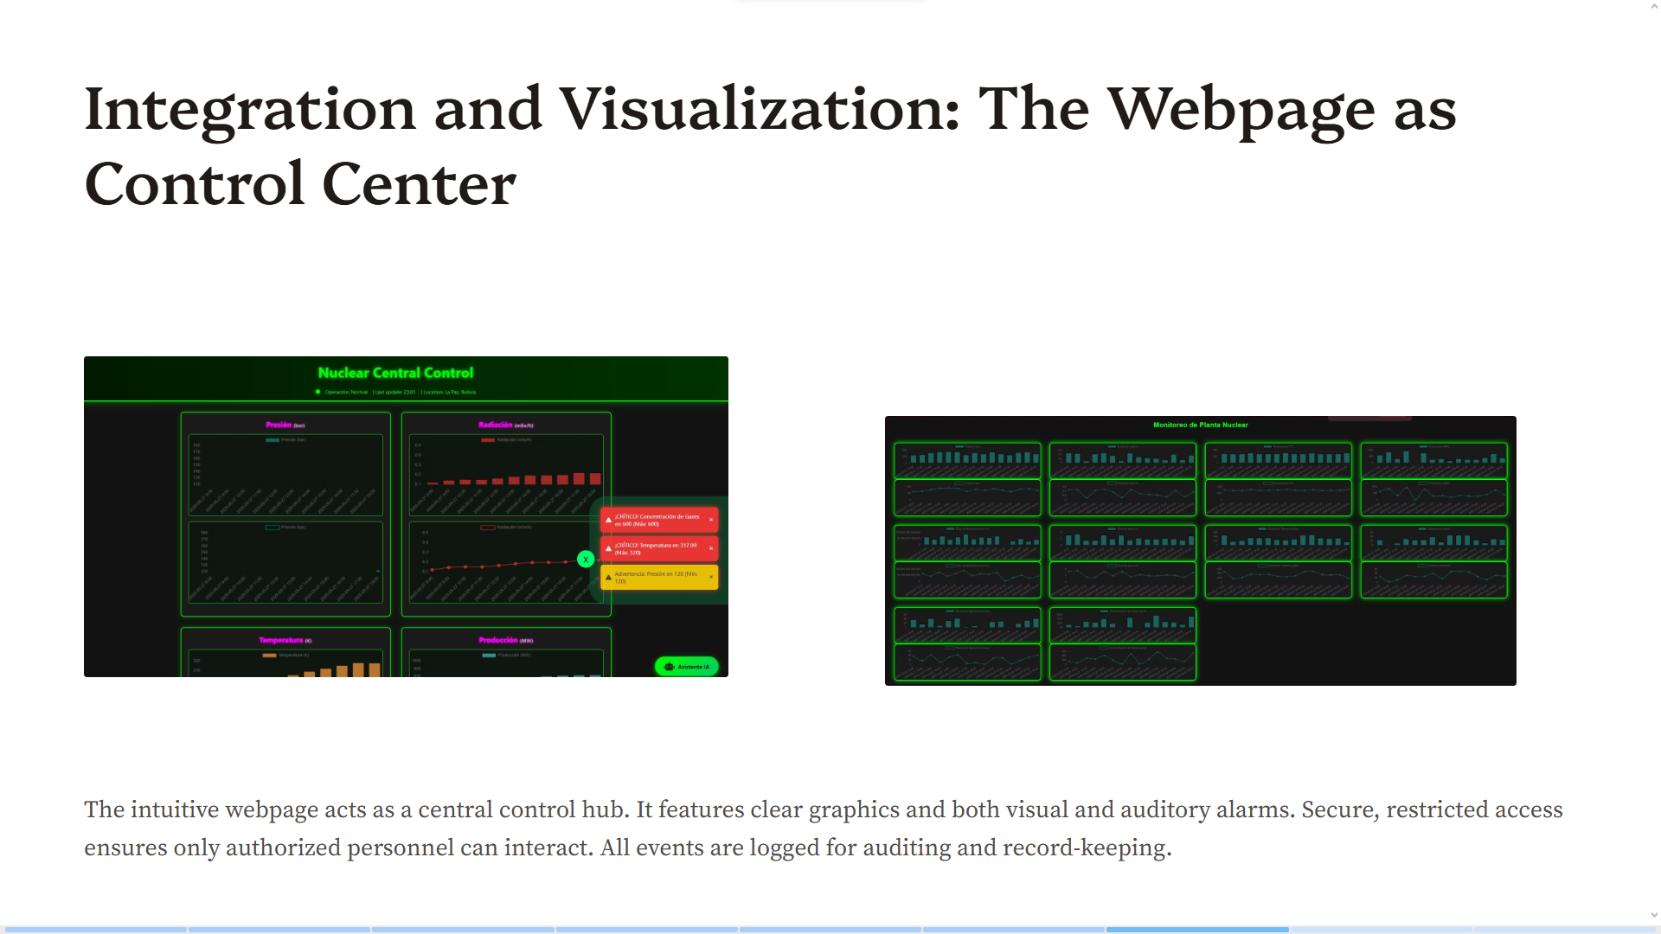

Slide 9
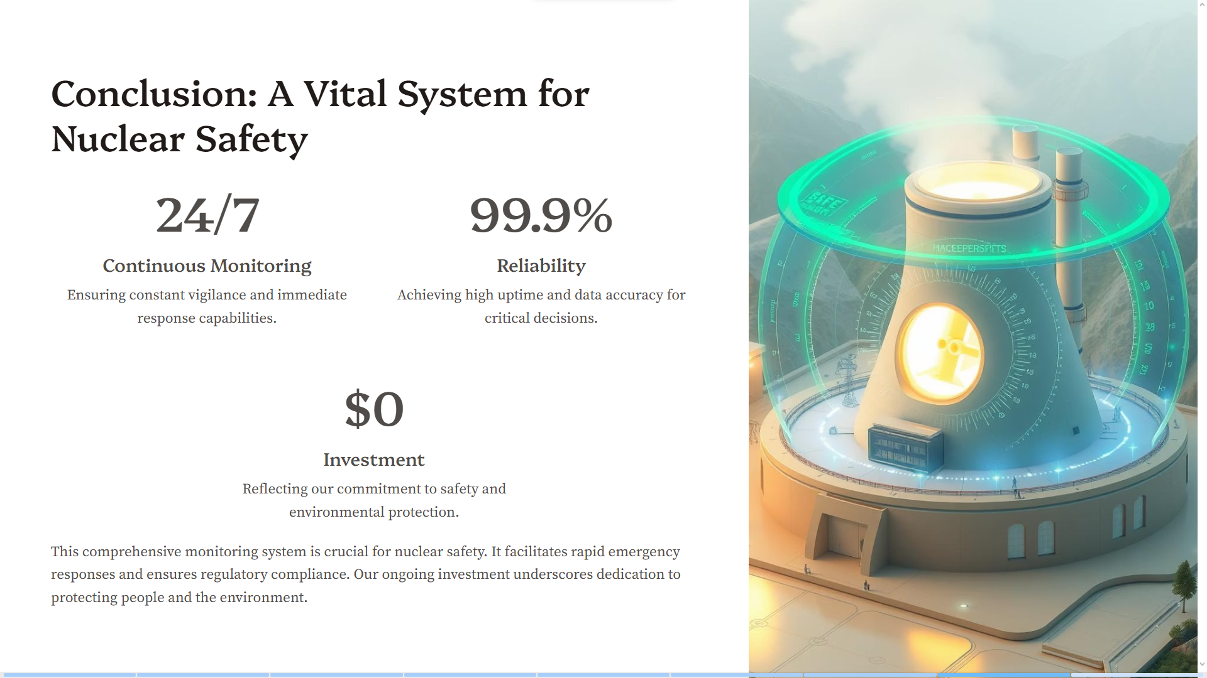

Slide 10
